Slide 1

Sans fight
CSCI-1260-002
Samuel Shelton

Slide 2
Overview
I made a Sans fight from Undertale
Difficultly going through this project
Demo

Slide 3
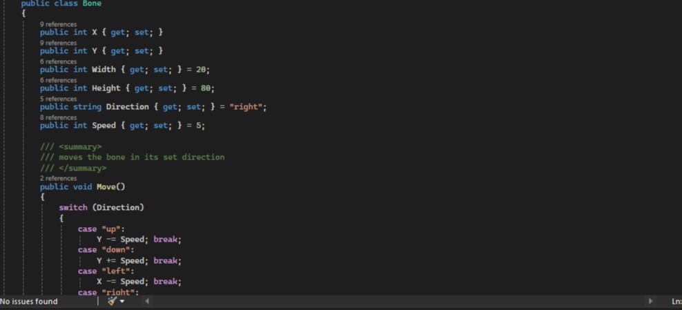
My thoughts
When I first did the adventure game project last semester, I knew that this is what I wanted to do for the final

Slide 4
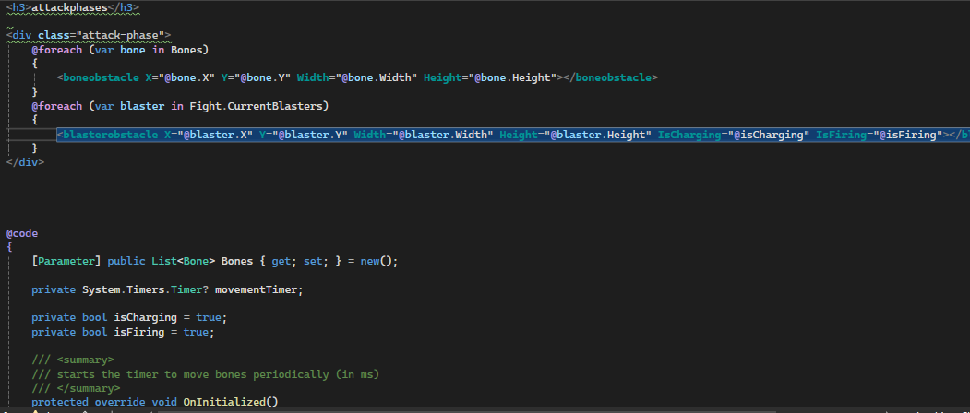
My thoughts pt.2
It was fun to work on this too. Had to do some googling for some referencing on dialogue lines and some overall structuring from what the game actually uses

Slide 5
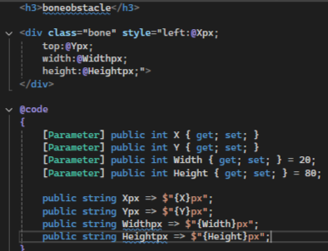
What was used
I used Blazor mainly because that has been what we used all semester, and I feel that I have better understanding and working knowledge of it than in 1250.
Little bit of google (for dialogue lines during the fight)

Slide 6
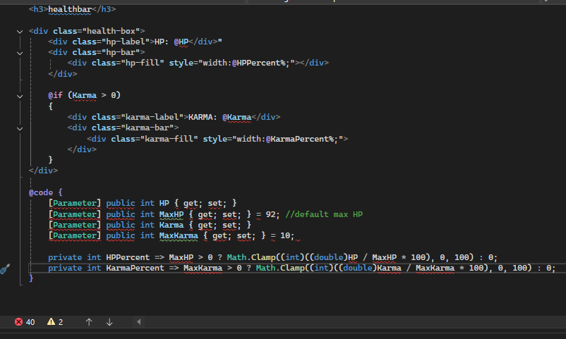
Difficulties
A lot of problems arose from this -------------------→
One of the biggest issues was how to incorporate the karma effect as this was something I also tried in the adventure game project
Motivation was another thing that was difficult to maintain
Overall, just making a boss fight felt daunting yet it was fun to make my rendition on an already uber-popular character

Slide 7
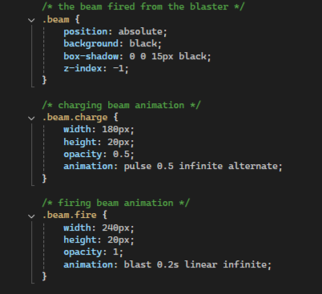
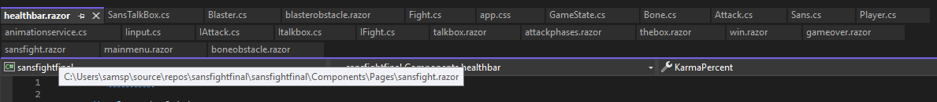
Some details
I did not realize that there would be so many .cs and .razor classes for this project which made it somewhat confusing when going between classes (looking back it now it might be too ambitious)
However, it was very interesting to dive into the app.css to “create” the bones and blasters that Sans uses for his attacks as well as the dialogue box and the box that the player moves around in. I also debated changing the fabicon.png icon to a Sans face as an extra touch.

Slide 8
summary
Overall, it was very fun to create something that I have a lot of interest in. I also felt that this was a big growth opportunity and that the whole six month ago thing is true.
I definitely feel that the project could be simplified because I did write some of the same lines of code more than twice and I also feel that the number of classes could be condensed
I understand now how indie game devs create their projects and I appreciate their efforts to create games like these

